Slide 1
GRIEF
“Grief is thoughts on loss, struggle, and new beginning s”
- Heike Mertins

Slide 2
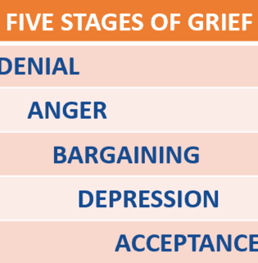
WHAT IS GRIEF?
There isn’t a single grief definition that encompasses everything. However, there are a few definitions that, together encompass what you are going through.
“Grief is the normal and natural emotional reaction to loss or change of any kind.”
“Grief is the conflicting feelings caused by the end of or change in a familiar pattern of behavior.”
“Grief is the feeling of reaching out for someone who’s always been there, only to discover when I need her [or him, them. etc] one more time, she’s no longer there.”

Slide 3
GRIEF AND CULTURE
Every culture has its own worldview. Within different cultures…
There is no correct way to mourn the loss of a loved one
Each culture has its own way of helping people cope with death and grief
Beliefs, rituals, and traditions specific to a person’s culture can provide some predictability and normalcy during a time that is difficult and confusing
“Carrying out these practices offers a sense of stability and security”. Understanding grief within a cultural context can challenge you to take on a different viewpoint of death and dying.

Slide 4
A VIDEO THAT MIGHT HELP
College student grief <4 minutes

Slide 5
COPING TIPS
1. Get support
Turn to friends, family, pets, support groups
2. Take care of yourself
Express your feelings in a tangible or creative way (art, writing, songs/music, etc.)
Look after your physical health (getting enough sleep, exercising, eating healthfully, avoiding alcohol or other drugs as attempts to cope)
Don’t let anyone tell you how to feel, and don’t tell yourself how to feel, either.
Plan ahead for grief “triggers” (anniversaries, holidays, and milestones can reawaken strong memories and feelings, and that’s completely normal)

Slide 6
COPING TIPS cont..
3. Seek out professional support if needed
“After a while, and with time, strong feelings in response to a loved one’s death should become less intense. However, if you find yourself unable to cope after an extended amount of time and find that the grief is getting in your way of living life, you should contact a professional for their support.”
~ Contact a grief counselor or professional therapist if you:
Feel like life is not worth living
Wish you had died with your loved one
Blame yourself for the loss or for failing to prevent it
Feel numb and disconnected from others for more than a few to several weeks
Are having difficulty trusting others since your loss
Are unable to perform your normal daily activities

Slide 7
TED TALK THAT MIGHT HELP
We don’t ”move on” from grief. We move forward with it >10 minutes

Slide 8
GUIDED MEDITATION FOR GRIEF & HEALING
Guided meditation for grief and healing >10 minutes

Slide 9
RESOURCES
1. CAPS on campus
2nd floor of Student Health Center
(707) 826 3236 (after-hours: 24/7 crisis support)
Call or come by to schedule a same day appointment, or, if you find yourself in crisis, come M-F 8 to 4:30 pm on the hour for a crisis appointment

Slide 10
RESOURCES cont.
2. Hospice of Humboldt (no insurance required for services)
Grief Support Services
2010 Myrtle Avenue, Eureka, CA 95501
(707) 445 8443
info@hospiceofhumboldt.org
http://www.hospiceofhumboldt.org/bereavement/

