Slide 1
UNDERSTANDING SELF-HARM
CAPS PRESENTATION

Slide 2
Quote:
“Talking about self-harm can be very stressful and bring up strong emotions. Don’t be discouraged if the situation feels worse right after sharing. Change is uncomfortable and will take time, but once you get through this hurdle, it will get better.”

Slide 3
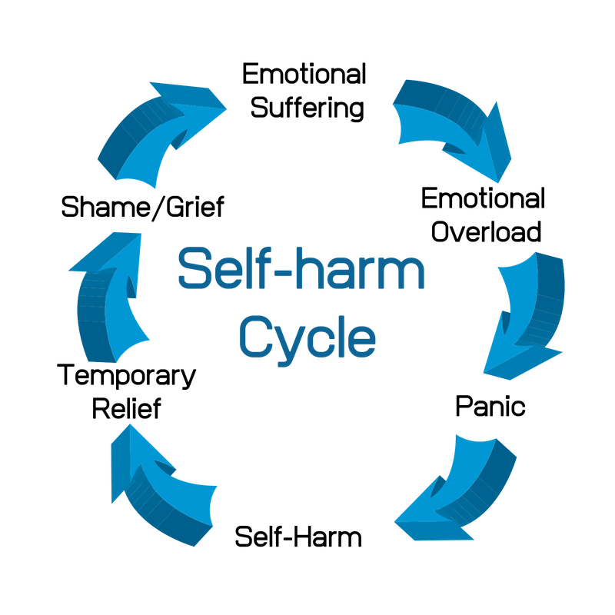
Self-Harm Explained
Self Harm is a way to cope with deep distress and emotional pain.
It may seem counterintuitive, but self-harm makes the person feel better.
It may help express feelings that aren’t easily expressed in words, be a distraction from life, or be a release of emotional pain.
Afterwards, a person probably feels better, but eventually the feelings return.

Slide 4
A video to help you understand
Linking and Reconceptualizing Different Forms of Self-Harming Behavior >10 minutes

Slide 5
Signs and Symptoms of Self-Harm
Self-harm includes anything intentionally done to harm yourself. Common forms include:
Cutting or severely scratching your skin
Burning or scalding yourself
Hitting yourself or banging your head
Sticking objects into your skin
Intentionally preventing wounds from healing
Swallowing poisonous substance or objects
Self-harm can include less obvious forms, such as driving recklessly, binge drinking, taking too many drugs, or having unsafe sex.

Slide 6
Warning Signs
Self-injury can be hard to detect, but there are some warning signs. Remember, you don’t need to see one of these signs in order to reach out to someone you care about.
Some signs include:
Wearing long sleeved shirts and pants even in hot weather
Needing to be alone for long periods of time, especially in a bathroom or bedroom
Isolation and irritability
Blood stains on towels or blood-soaked tissues
Sharp objects in the person’s belongings
Frequent “accidents”

Slide 7
A video that may help you understand
Explaining self-harm <10 minutes

Slide 8
Misconceptions about Self-Harm
Since self-harm is deemed a taboo subject, many people harbor serious misconceptions about the motivations to self-harm and the mental state of people who self-harm.
Don’t let these myths get in the way of getting help or helping someone you care about.

Slide 9
Myths and Facts
Myth: People that cut and self injure are trying to get attention.
Fact: The painful truth is that most people who self-injure do it secretly. They may go to great lengths to conceal their acts. Shame and fear often make it very difficult for these individuals to come forward and ask for help.

Slide 10
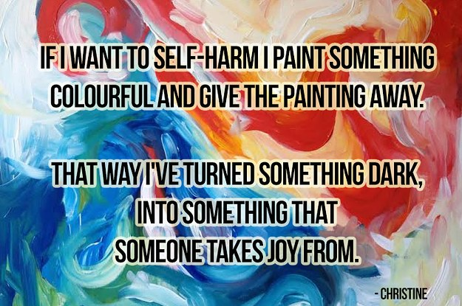
Myths and Facts cont.
Myth: People who self-injure are crazy and/or dangerous
Fact: It is true that many people that self-injure are suffering from anxiety, depression, or a previous trauma -- just like millions of other people in the United States. Self-injury is how they cope. Calling them crazy or dangerous isn’t accurate or helpful.

Slide 11
How does self-harm help?
It’s important to recognize that self-harm serves a purpose, otherwise you wouldn’t do it. Some ways self-harm can help include:
Expressing feelings you can’t put into words
Releasing pain and tension you feel inside
Helping you feel in control
Distracting you from emotions or life’s problems
Relieving guilt or punishing yourself
Makes you feel alive, or feel something rather than numb
Once you recognize your reasons for self-harm, you can learn ways to replace self-harm with other coping mechanisms

Slide 12
If self-harm helps, why stop?
Although self-harm gives you temporary relief, it comes at a price.
It is usually quickly followed by feelings of guilt and shame. The secret can distance you from friends and family thus increasing feelings of loneliness. Also, there is a real risk of serious injury or the development of other issues like major depression, drug/alcohol addiction and suicide,
Self-harm can also become addictive and turn into a compulsive behavior that seems impossible to stop.
Self-injury does not help you with the issues that made you start self-harming in the first place.

Slide 13
A video to help you comprehend
From scars to strength: The poetry of recovery >10 minutes

Slide 14
Seeking Help
If you are ready to get help for self-harm, there are a few steps you can take.
Confide in someone
Figure out the why
Develop new coping skills

Slide 15
STEP 1: CONFIDE IN SOMEONE
It can be difficult to talk about the very thing you have tried so hard to hide, but it can also be a relief to finally let go of your secret
Also, it can be difficult to decide who to talk to. Choose someone you feel will be supporting and will not gossip or be controlling. This can be a friend, religious leader, teacher, counselor, or relative
Sometimes it is easier to open up to someone that you respect who has some distance from the situation such as a counselor, religious leader, or teacher

Slide 16
Tips for talking about self-harm
1. Focus on the feelings, not the physical act: This helps the person understand where you’re coming from
2. Communicate in the way you are most comfortable: If you are too nervous to talk in person, start with a letter. Remember you don’t have to share anything you aren’t ready to share
3. Give the person time to process what you have told them: Just as it is hard for you to tell them, it can be hard to hear, especially if they have a close relationship with you

Slide 17
STEP 2: FIGURE OUT WHY
Finding the why of your self-harming is a vital step in recovery. If you can determine the purpose of your self-harm, you can then find other ways to get those needs met
Try to identify your triggers. It may be beneficial to start a journal and keep track of the times you were triggered to self-harm. Remember that self-harm is usually a way of dealing with emotional pain, so be sure to include what you were feeling at the time
The idea of being aware of your emotions may be frightening. You may be afraid of becoming overwhelmed and never being able to get rid of the pain, but the truth is emotions can quickly come and go if you let them. If you don’t fight or judge yourself over the feeling, you will find that it fades quickly and is replaced by another. It is only when you obsess over the feeling it persists.

Slide 18
Video that may help
Why I cut myself <10 minutes

Slide 19
STEP 3: DEVELOP NEW COPING SKILLS
Right now, self-harm is your way of dealing with difficult emotions and situations. So, if you are going to stop, you need something to replace it. Depending on why you self-harm, there are various coping skills you can use.
If you’re self-harming to express pain and intense emotions:
Paint, draw, or scribble your feelings on paper
Write your feelings down in a journal
Compose a poem or song
Write out your emotions, then rip up the paper
Listen to music that expresses how you feel

Slide 20
STEP 3 cont.
If you’re self-harming to calm or soothe yourself:
Take a bath or hot shower
Pet or cuddle a dog or cat
Wrap yourself in a warm blanket
Massage your neck, hands, and feet
Listen to calming music
If you’re self-harming because you feel disconnect or numb:
Call a friend (you don’t have to talk about self-harm)
Take a cold shower
Chew on something with a strong taste like chili peppers, peppermint, or grapefruit
Go online to a self-help website, chat room, or message board

Slide 21
A video to help cope
How to paint your mind >10 minutes

Slide 22
Getting professional help
You may need the help and support of a trained professional. A therapist can help you figure out your “why” and help you develop new coping skills.
Finding the right therapist can be hard. There should be a sense of trust and warmth. Trust your instincts. If it doesn’t feel right, it probably isn’t.

Slide 23
Getting professional help cont.
If you don’t where to turn, you can call S.A.F.E Alternatives Informational hotline at (800) 366-8288
If you are in a crisis, you can call the National Suicide Prevention hotline at (800) 273-8255
Also, you can call HSU CAPS at (707) 826-3236 to access crisis counseling. CAPS has in-person services weekdays 8 to 4:30 pm or you can talk with a therapist by phone after-hours or weekends

Slide 24
Info for friends and family
Maybe you’ve noticed some peculiar scars on a friend or loved one, or someone has confided in you about their self-harm. Whatever the case, there are some important points to keep in mind.
Deal with your own feelings. You may feel confused, shocked, angry, or disgusted about the self-harming behaviors. Then you may feel guilty about feeling that way. Acknowledge your feelings. They are the first step to helping your friend or loved one.
Learn about the problem. Try to understand why they’re self-harming.
Don’t judge. Avoid judgmental comments or criticisms. Remember, the person who self-harms already feels ashamed and lonely.
Offer support, not ultimatums. Threats are counterproductive and make things worse. Recovery doesn’t happen overnight.

Slide 25
RESOURCES
Check out the CAPS website. It is full of resources!
ULifeline has resources specifically for college students!
Self-Injury Outreach and Support has a lot of resources!

