Slide 1
Losing Yourself to Find A Major
Integrating Loss Experiences to Inform Your Life’s Work
Johneen Manno, MA
Licensed Therapist / Graduate Practicum Coordinator
HSU Counseling and Psychological Services

Slide 2
What we will learn:
New perspectives about choosing your life’s work
Start the journeyS

Slide 3
People Change Jobs and Careers Data extracted from article in online blog called the balance, "How Often Do People Change Careers" (Rosenberg McKay, 4/4/17).

Slide 4
Ways People May Choose a “Career” or “Major”
Occupational Outlook Handbook (post-assessments)
Use the Creative Process and allow yourself to “hang in ambiguity” for an “aha moment”
Integrate you life losses – this is what you passionately bring to the table

Slide 5
Integrating Your Life Losses
Integrate
Breathe deep
Cry and grieve
Breathe deeper
Make new meaning

Slide 6
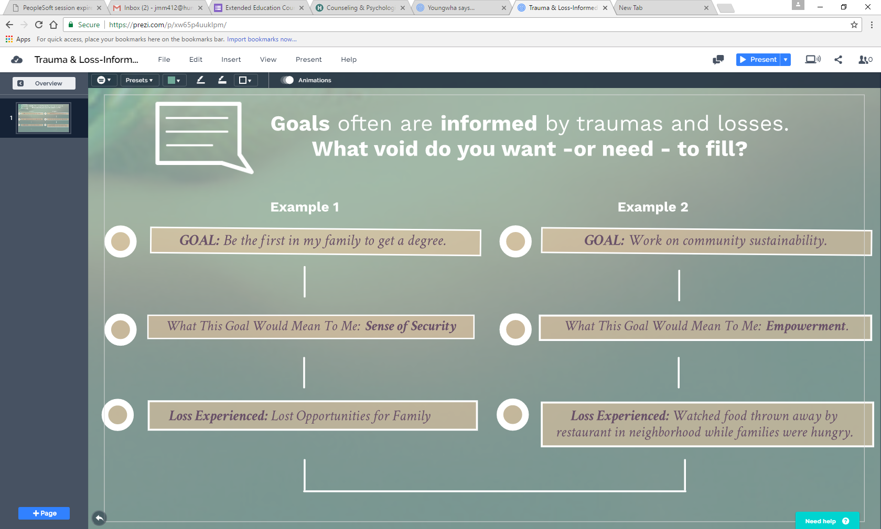

Slide 7
Start the Journey – Life Planning Sheet Tips
Losses are varied and can occur in multiple combinations.
If one loss is not processed, you will feel it when another loss occurs in your life. Losses compound upon themselves.
START WITH YOUR PASSION, not a job title.
Life work (vs. “Career” or “major”) interests can change as you change.
15 min insight exercise
Solo work

Slide 8
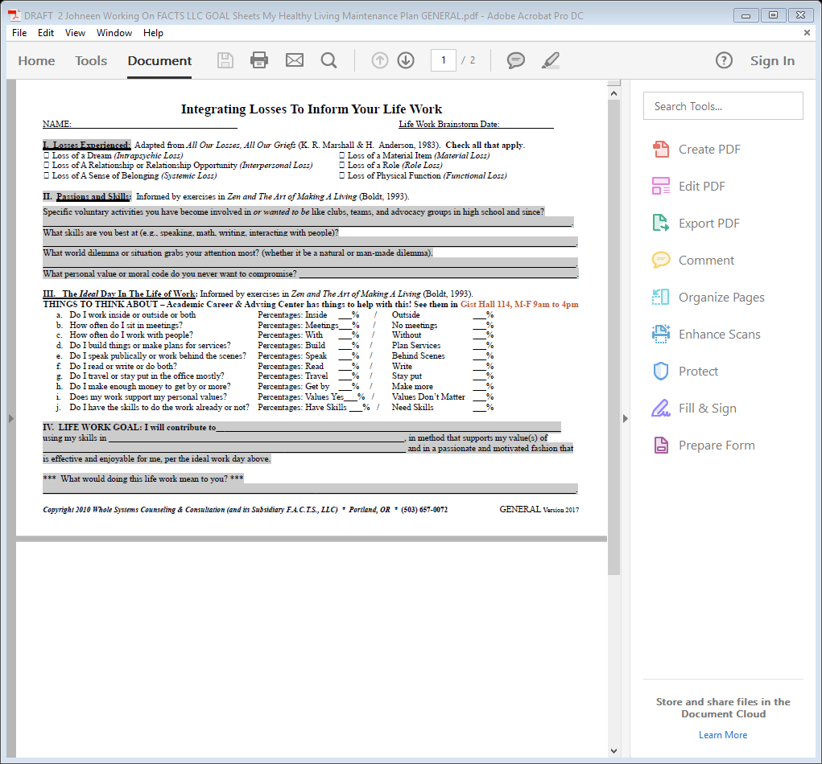

Slide 9
Assess – Identify Your Patterns CHALLENGE QUESTION is at the end: What would this life work mean to you?
5 min
reflect exercise
Small group work

Slide 10
REMEMBER . . .

Slide 11
Affirmation
5 min
reflect exercise
LARGE group work

Slide 12
Additional resources
Summary of what we will learned:
New perspectives about choosing your life’s work
Start the journeyS
Academic and Career Advisement Center (ACAC)
Gist Hall 114
Appointments: Mon.-Fri. 9 am – 4 pm
Drop-in Advising: Mon.-Fri 10 AM – 1 PM
Call 707-826-3341 to set up an appointment
acac@humboldt.edu
www.humboldt.edu/acac

